Slide 1
STUDENT CAREER SUCCESS PREDICTOR
CAPSTONE PROJECT
Presented By: 1. Student Name- Prashant Mishra 2. College Name- Babasaheb Bhimrao Ambedkar University 3. Department – Information Technology 4. AICTE STU-ID – STU69c37c3b032931774419003

Slide 2
OUTLINE
Problem Statement
Proposed System / Solution
System Development Approach (Technology Used)
Algorithm & Deployment
Result
Conclusion
Future Scope
References

Slide 3
Problem Statement
Students often struggle to estimate how prepared they are for campus placement because academic performance, technical skills, projects, internships and soft skills interact in complex ways. Traditional career guidance is frequently qualitative and does not provide a consistent, data-driven estimate of placement readiness. A practical system is needed to analyse a student profile and classify the likely placement status as Placed or Not Placed.

Slide 4
Proposed Solution
Data: Use the Student Career Success dataset containing 50,000 student records and 29 features.
Preprocessing: Clean the data, remove leakage/noise features, encode categorical values, impute missing values and scale numeric inputs.
Feature Engineering: Create a composite Readiness_Score from resume, interview, programming, problem-solving, projects and internships.
Modeling: Compare Logistic Regression, Random Forest, Extra Trees, Gradient Boosting, XGBoost and LightGBM.
Prediction: Use the best-performing tuned pipeline to classify Placement_Status as Placed or Not Placed.
Application: Provide an interactive Streamlit interface for entering a student's academic, technical and soft-skill profile.

Slide 5
System Approach
Programming Language: Python
Data Processing: Pandas, NumPy
Machine Learning: Scikit-learn, XGBoost, LightGBM
Preprocessing: SimpleImputer, StandardScaler, OrdinalEncoder, One-Hot Encoding
Model Selection: 5-fold Stratified Cross-Validation using weighted F1
Optimization: RandomizedSearchCV and decision-threshold tuning
Web Framework: Streamlit
Model Persistence: Joblib
Version Control: Git and GitHub

Slide 6
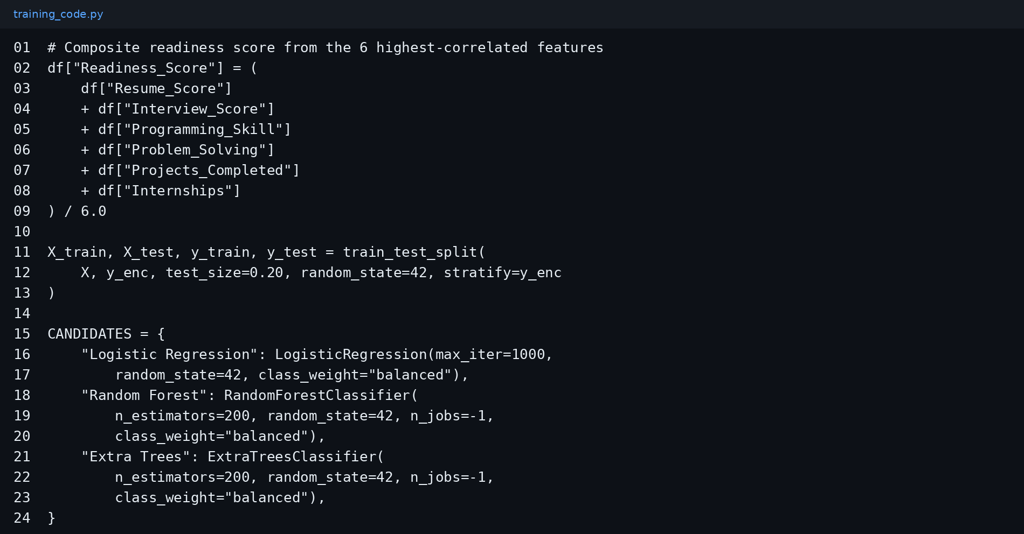
Algorithm & Deployment
Algorithm: Random Forest Classifier was selected as the best model in the repository's model comparison.
Training: 80/20 stratified train-test split followed by 5-fold cross-validation.
Tuning: RandomizedSearchCV is applied to the best candidate model; the decision threshold is tuned to maximise weighted F1.
Deployment: The trained pipeline is saved with Joblib and loaded by the Streamlit web application.

Slide 7
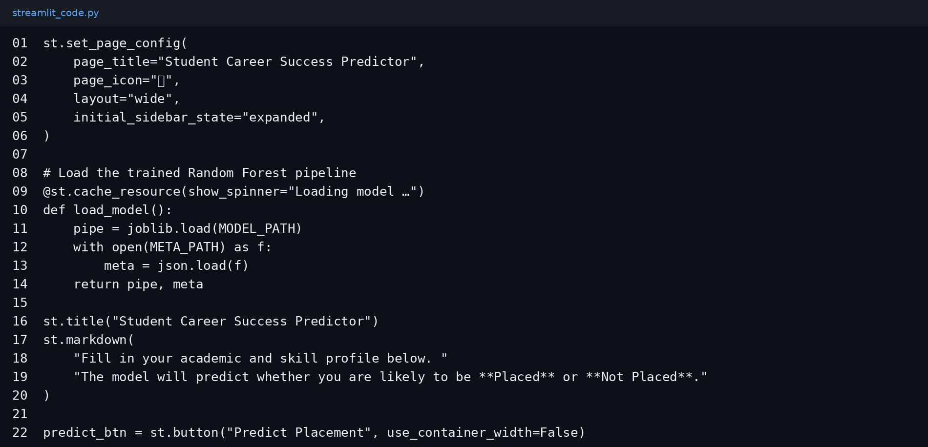
Result
Dataset: 50,000 records | 29 features
Best Model: Random Forest Classifier
Cross-Validation F1: ≈ 79.95%
Test Accuracy: 79.4%
Test ROC-AUC: 0.7964
The Streamlit interface accepts academic, technical, soft-skill and profile inputs and returns a placement prediction.

Slide 8
Conclusion
The project demonstrates an end-to-end machine learning workflow for student placement prediction.
A structured preprocessing pipeline and feature engineering step improve the consistency of model inputs.
Random Forest achieved the strongest cross-validation performance among the compared models in the repository.
The final solution is exposed through an interactive Streamlit application, making the model accessible without requiring users to write code.

Slide 9
Add explainable-AI outputs such as SHAP-based feature contribution for individual predictions.
Introduce calibration and fairness analysis across student groups.
Track model drift and periodically retrain the model using newer placement outcomes.
Add personalized skill-gap recommendations based on the student's predicted readiness.
Expose the model through an API for integration with college placement or student-support portals.
Future scope

Slide 10
References
GitHub repository: p4xprime/student-career-success-predictor
Kaggle – Student Career Success Prediction Dataset
Python documentation
Pandas documentation
NumPy documentation
Scikit-learn documentation
Streamlit documentation
XGBoost documentation
LightGBM documentation

Slide 11
Deployment link / github link
Github Link: https://github.com/p4xprime/student-career-success-predictor
Deployment Link : https://primestudent-career-success-predictor.streamlit.app
Repository contains: app.py, train_model.py, dataset, trained model and metadata.

Slide 12
THANK YOU

